Slide 1

Python Fundamentals
Innovation Masters
Day 4

Slide 2
Previously on Python Programming
Variables
Take user input
Typecasting
Strings
Adding Strings
len()

Slide 3
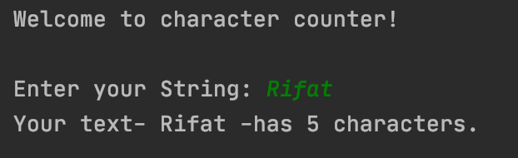
Character counter
Take an input String from user and return how many characters are in the string in a well-presented form.

Slide 4



Decision Making
All programs have to make decisions as to what to do with the input
We code these decisions from before
Examples:
Airplane ticket, if under-age ticket price is half, or else full price
While driving, if red light then stop, and if green light then go
For computer, if battery low dim brightness and show message, or else operate normally
For Roomba, if nothing ahead go straight, if wall in front turn left or right

Slide 5

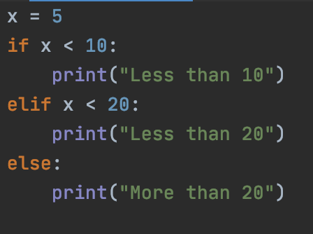
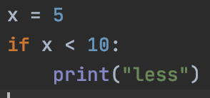
Conditional Statements
For programming we use if/else statements to make decisions

Slide 6
Let’s code a simple program
Take age from user, print age and respond with an appropriate message:
If age < 21
You are underage
If age == 21
….
If age > 21
You are overage

Slide 7
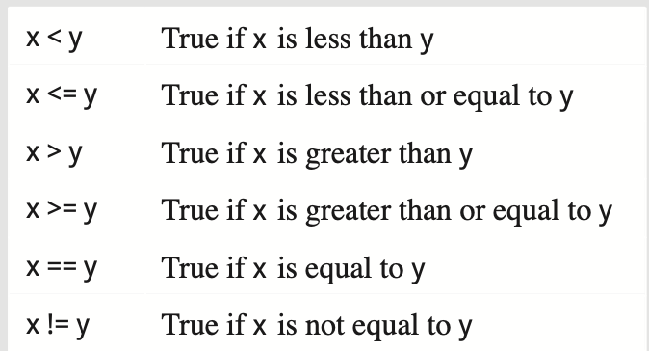
Boolean operators

Slide 8
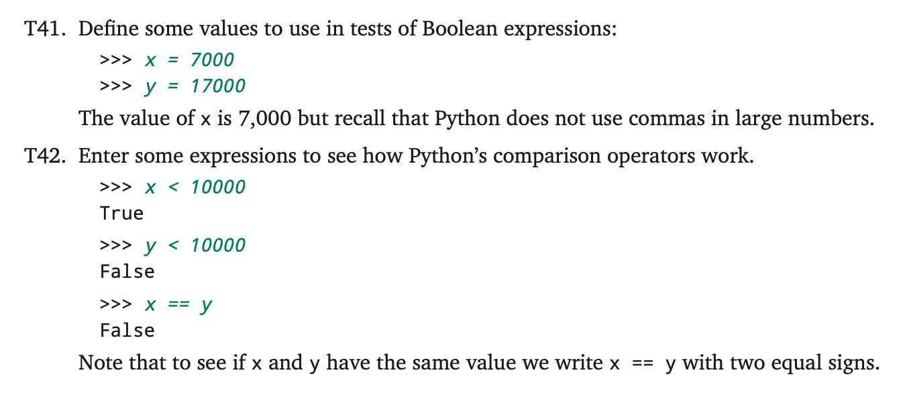
Let’s check the operators

Slide 9
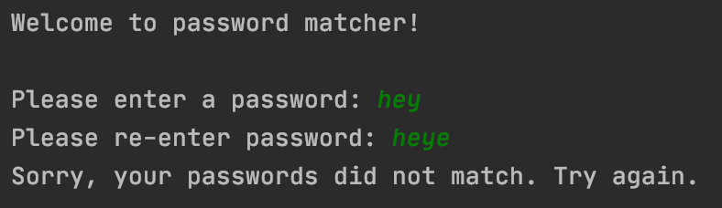
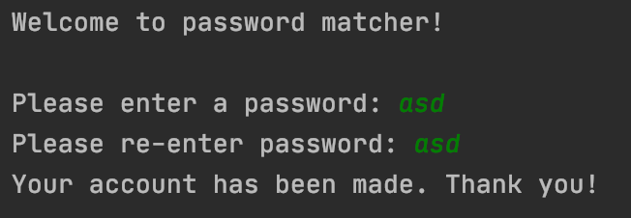
Password matcher
Take two inputs from user and match if they are the same. Respond accordingly.

Slide 10
Homework- Profile Maker
Take in some information from the user and construct a profile for him
Input:
First name
Last Name
Birth year
Hourly wage
Output:
Last, First
Age
Age title
Weekly salary

Slide 11
More details
Age
You need to figure out age from birth year, Hint: 2020 - birthyear = age
Age title
Age titles: 0<= kid <=12; 13<= teen <=19; 20<= adult <=60; 60< old
Salary
Find weekly salary from hourly wage (assume 40 working hours in a week)
Name
LastName, FirstName
Hint: Salary = hourly wage*40

Slide 12
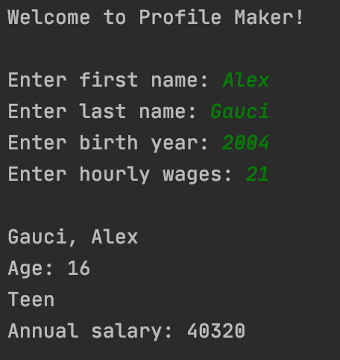
Demo input/output

Slide 13


Tech Talk
https://www.youtube.com/watch?v=uKcZxwTAVEM&t=29s
Who else has something to share?

